Slide 1


Bharati Vidyapeeth
(Deemed to be University)
College of Engineering, Pune
Presentation on
“To develop a social media website”
SUBMITTED BY
APURVA THAKUR 2214110264
SHRESHTHA RAJ 2214110262
AVINASH PATHAK 2214110258
BVDUCOE ,PUNE SUBMITTED TO PROF. T.B.PATIL

Slide 2
Acknowledgement
We would like to express deepest appreciation towards Dr Vidula Sohoni, Principal, Bharati Vidyapeeth (Deemed to Be University) College of Engineering, Pune and Dr Sandeep Vanjale, Head of Department of IT, who invaluably supported us in completing this project. We are profoundly grateful to Prof. T.B.Patil , Project guide for his expert guidance and continuous encouragement throughout to see that this project right, its target since its commencement to its completion. At last, we must express our sincere heartfelt gratitude to all the staff members of IT Department who helped us directly or indirectly during this course of work.
BVDUCOE ,PUNE SUBMITTED TO PROF. T.B.PATIL

Slide 3
Introduction
What is a Social media website?
Social media is a collective term for websites and applications that focus on communication, community-based input, interaction, content-sharing and collaboration.
People use social media to stay in touch and interact with friends, family and various communities. Businesses use social applications to market and promote their products and track customer concerns.
Social media has enormous traction globally. Mobile applications make these platforms easily accessible. Some popular examples of general social media platforms include Twitter, Facebook and LinkedIn.
BVDUCOE ,PUNE SUBMITTED TO PROF. T.B.PATIL

Slide 4
What are the benefits of social media?
User visibility. Social platforms let people easily communicate and exchange ideas or content.
Business and product marketing. These platforms enable businesses to quickly publicize their products and services to a broad audience. Businesses can also use social media to maintain a following and test new markets. In some cases, the content created on social media is the product.
Audience building. Social media helps entrepreneurs and artists build an audience for their work. In some cases, social media has eliminated the need for a distributor, because anyone can upload their content and transact business online.
BVDUCOE ,PUNE SUBMITTED TO PROF. T.B.PATIL

Slide 5
What are the challenges of social media?
Mental health issues. Overuse of social apps can result in burnout, social media addiction and other issues.
Polarization. Individuals can end up in filter bubbles. They create the illusion of open discourse when the user is actually sequestered in an algorithmically generated online community.
Disinformation. Polarized environments foster the spread of disinformation where the perpetrator's intent is to deceive others with false information.
BVDUCOE ,PUNE SUBMITTED TO PROF. T.B.PATIL

Slide 6
Elements required to create a social media website :
Creating a social media website involves a combination of front-end and back-end technologies. Front-end and Backend are the two most popular terms used in web development. The front end is what users see and interact with and the backend is how everything works. Each side needs to communicate and operate effectively with the other as a single unit to improve the website’s functionality.
The front end is the part of the website users can see and interact with such as the graphical user interface (GUI) and the command line including the design, navigating menus, texts, images, videos, etc. The backend, on the contrary, is part of the website users cannot see and interact with.
The visual aspects of the website that can be seen and experienced by users are frontend. On the other hand, everything that happens in the background can be attributed to the backend.
Languages used for the front end are HTML, CSS, and JavaScript while those used for the back end include Java, Ruby, Python, and .Net.
BVDUCOE ,PUNE SUBMITTED TO PROF. T.B.PATIL

Slide 7
Front End Languages :-
The front-end portion is built by using some languages which are discussed below:
HTML: HTML stands for Hypertext Markup Language. It is used to design the front-end portion of web pages using a markup language. HTML is a combination of Hypertext and Markup language. Hypertext defines the link between web pages.
CSS: Cascading Style Sheets fondly referred to as CSS is a simply designed language intended to simplify the process of making web pages presentable. CSS allows you to apply styles to web pages.
JavaScript: JavaScript is a famous scripting language used to create magic on sites to make the site interactive for the user. It is used to enhance the functionality of a website to run cool games and web-based software. Applicable in both front-end and back-end, Javascript is key to becoming a good developer.
BVDUCOE ,PUNE SUBMITTED TO PROF. T.B.PATIL

Slide 8
Back End Languages :-
The back-end portion is built by using some languages which are discussed below:
PHP: PHP is a server-side scripting language designed specifically for web development. Since PHP code is executed on the server side, it is called a server-side scripting language.
C++: It is a general-purpose programming language and is widely used nowadays for competitive programming. It is also used as a backend language.
Java: Java is one of the most popular and widely used programming languages and platforms. It is highly scalable.
Python: Python is a programming language that lets you work quickly and integrate systems more efficiently. It is also a very important language for the back end.
BVDUCOE ,PUNE SUBMITTED TO PROF. T.B.PATIL

Slide 9

Node.js: Node.js is an open-source and cross-platform runtime environment for executing JavaScript code outside a browser. You need to remember that NodeJS is not a framework, and it’s not a programming language. Most people are confused and understand it’s a framework or a programming language. We often use Node.js for building back-end services like APIs like Web App or Mobile App. It’s used in production by large companies such as Paypal, Uber, Netflix.
BVDUCOE ,PUNE SUBMITTED TO PROF. T.B.PATIL

Slide 10
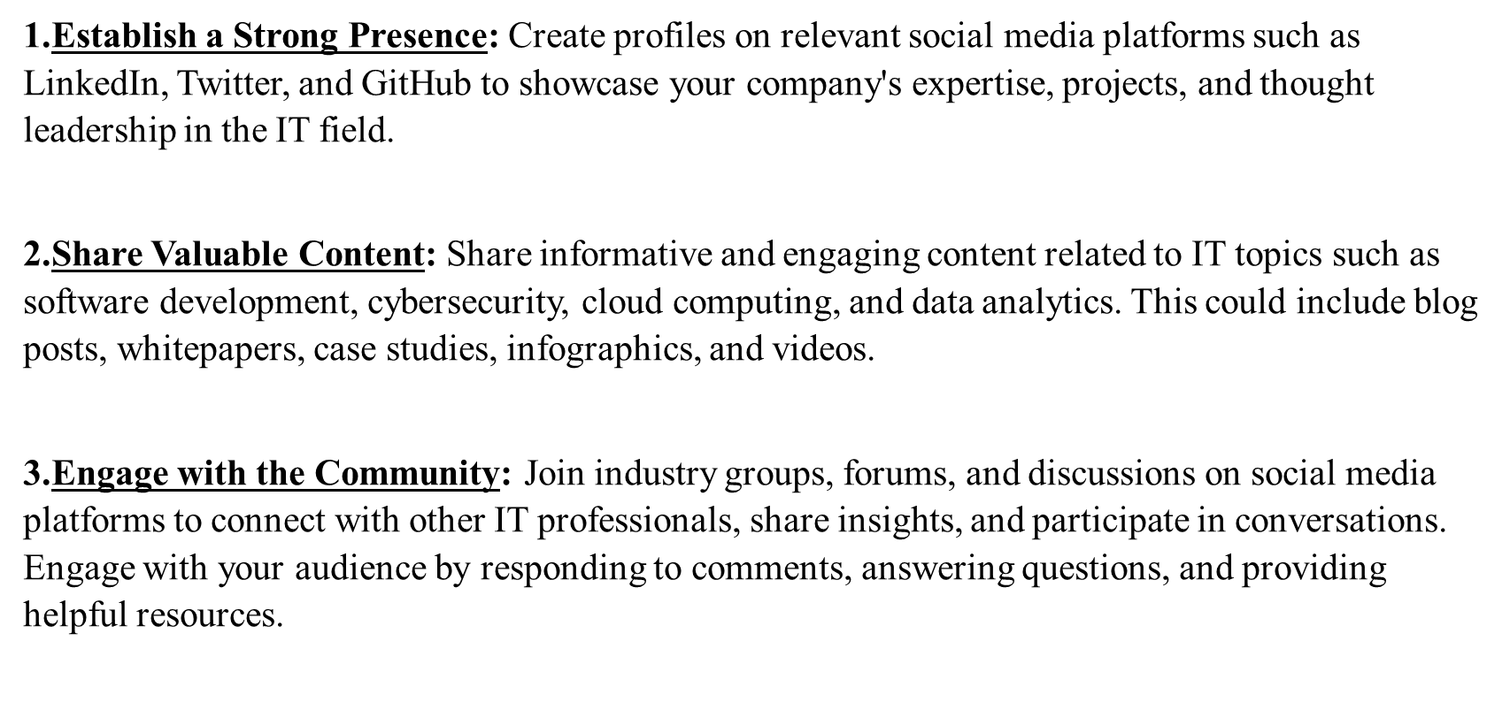
Role of ITM :-
BVDUCOE ,PUNE SUBMITTED TO PROF. T.B.PATIL

Slide 11
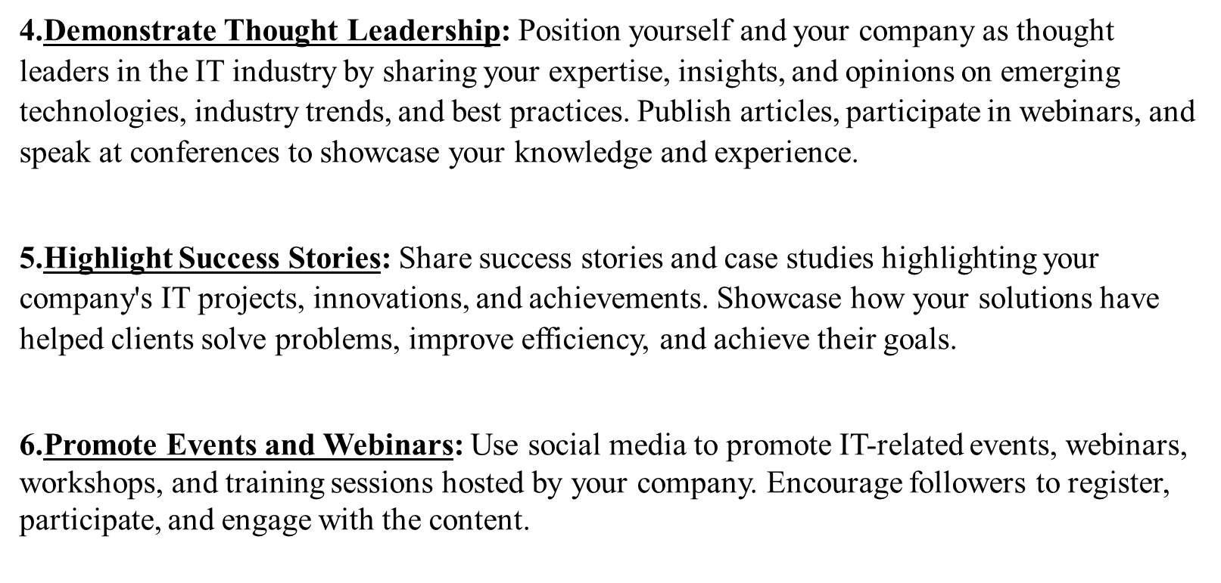
BVDUCOE ,PUNE SUBMITTED TO PROF. T.B.PATIL

Slide 12
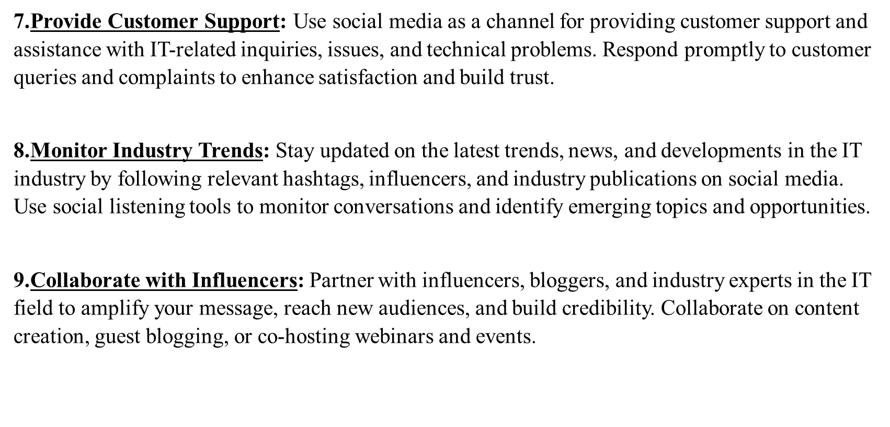
BVDUCOE ,PUNE SUBMITTED TO PROF. T.B.PATIL

Slide 13
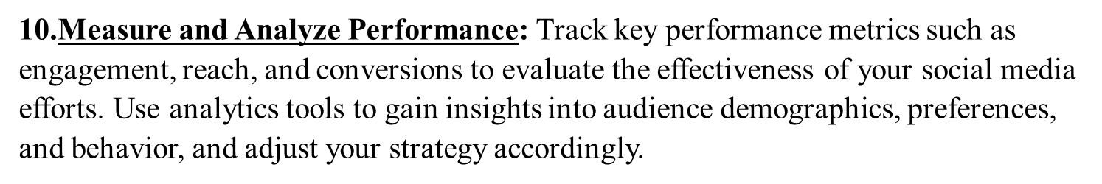
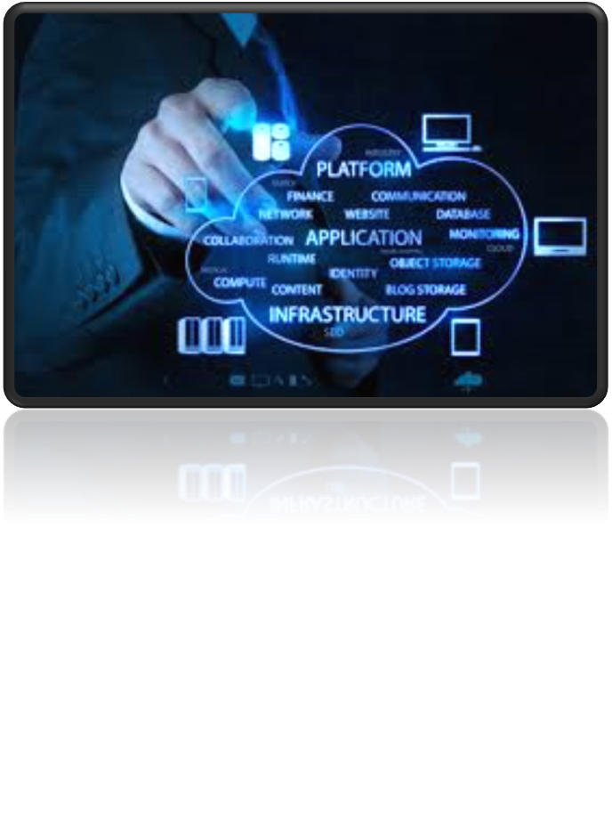
BVDUCOE ,PUNE SUBMITTED TO PROF. T.B.PATIL

Slide 14
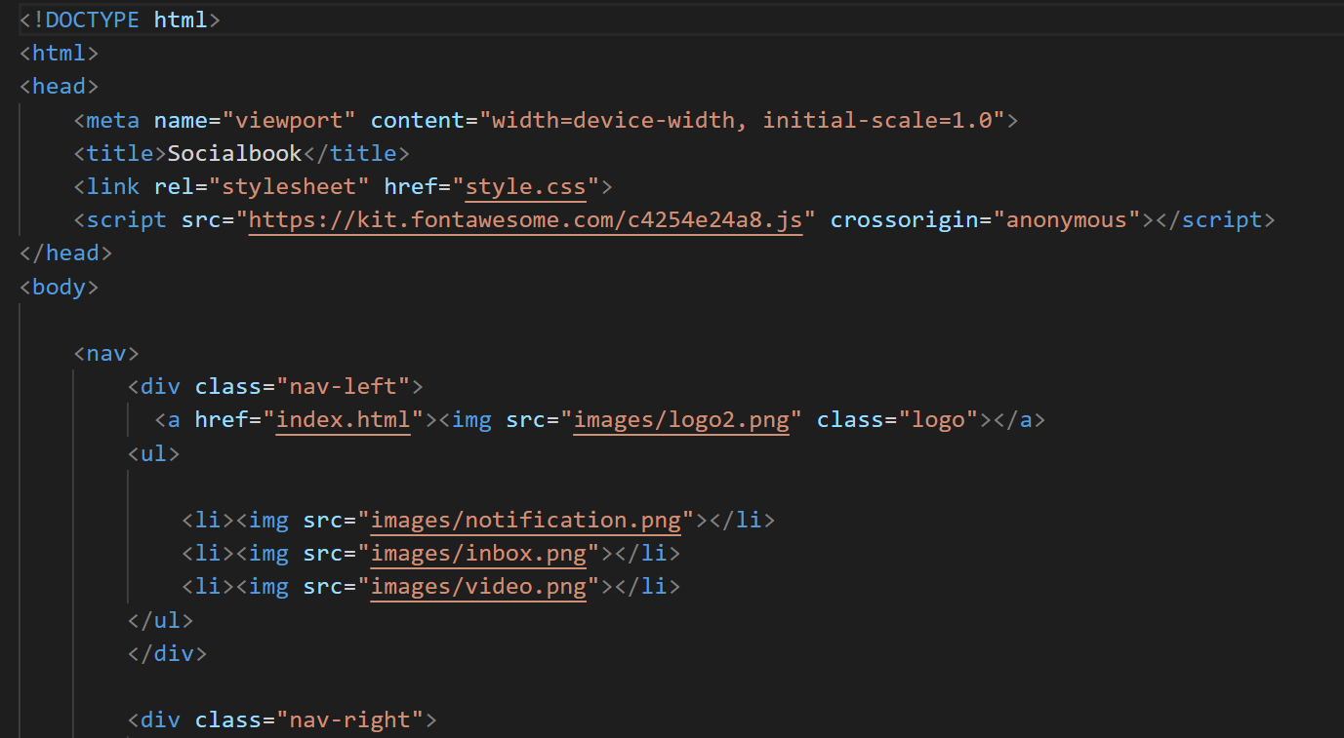
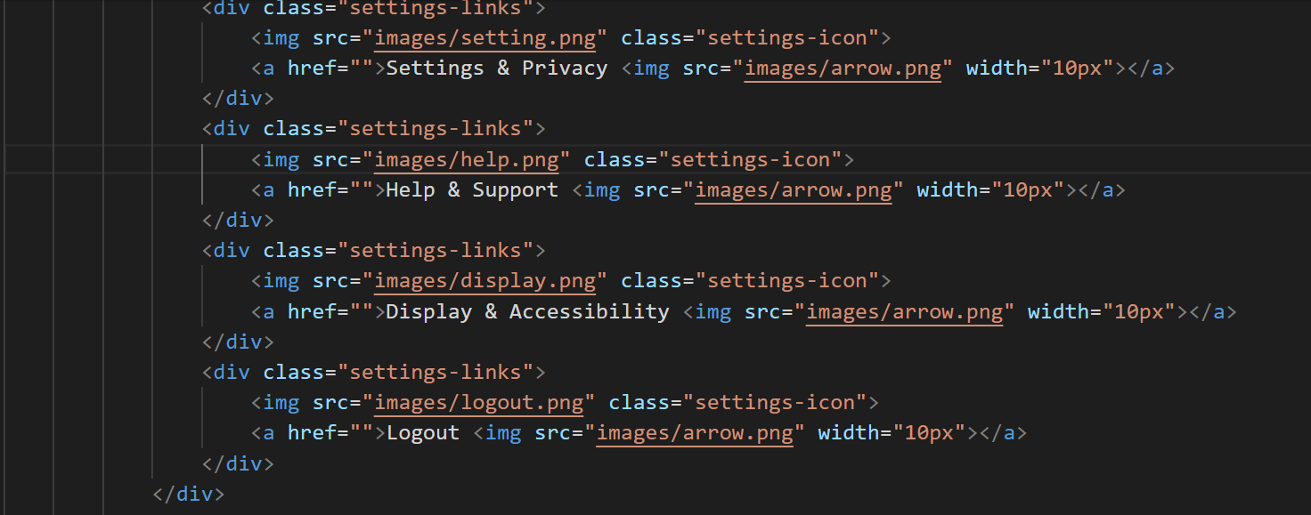
Code :-
BVDUCOE ,PUNE SUBMITTED TO PROF. T.B.PATIL

Slide 15
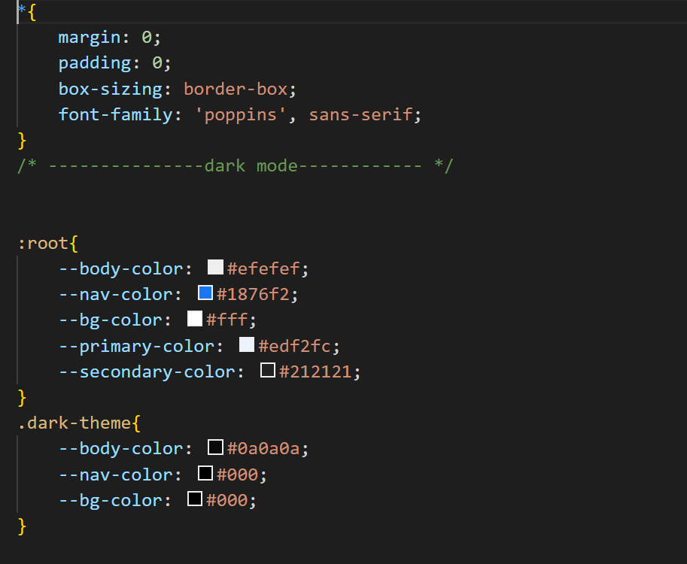
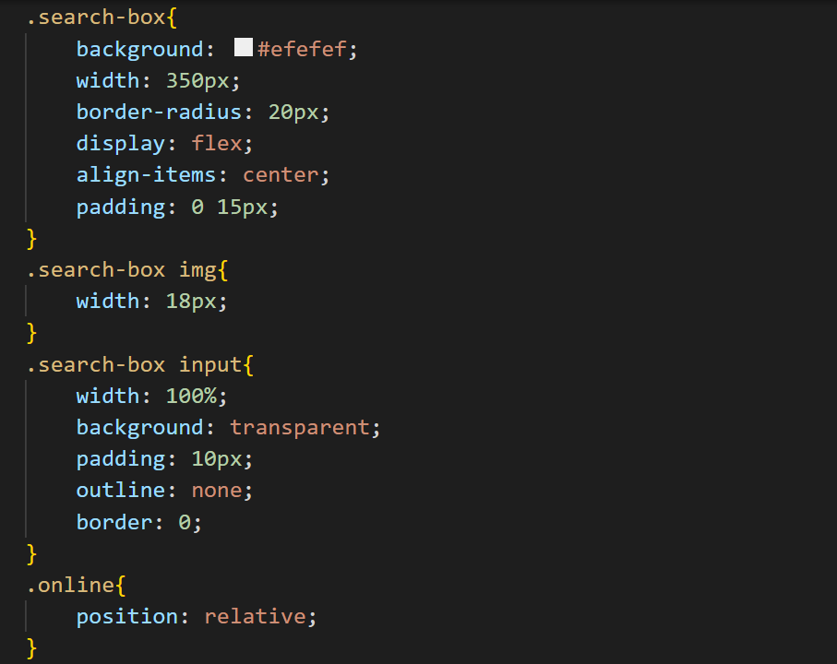
BVDUCOE ,PUNE SUBMITTED TO PROF. T.B.PATIL

Slide 16
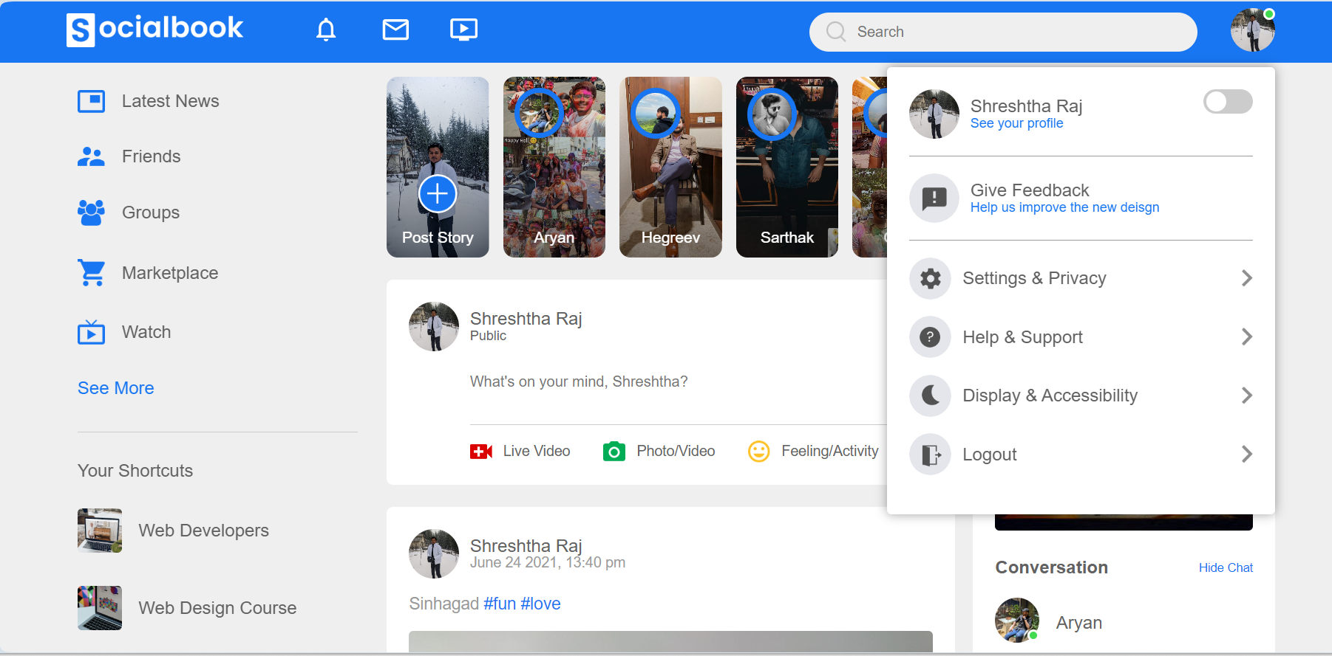
Output:-
BVDUCOE ,PUNE SUBMITTED TO PROF. T.B.PATIL

Slide 17
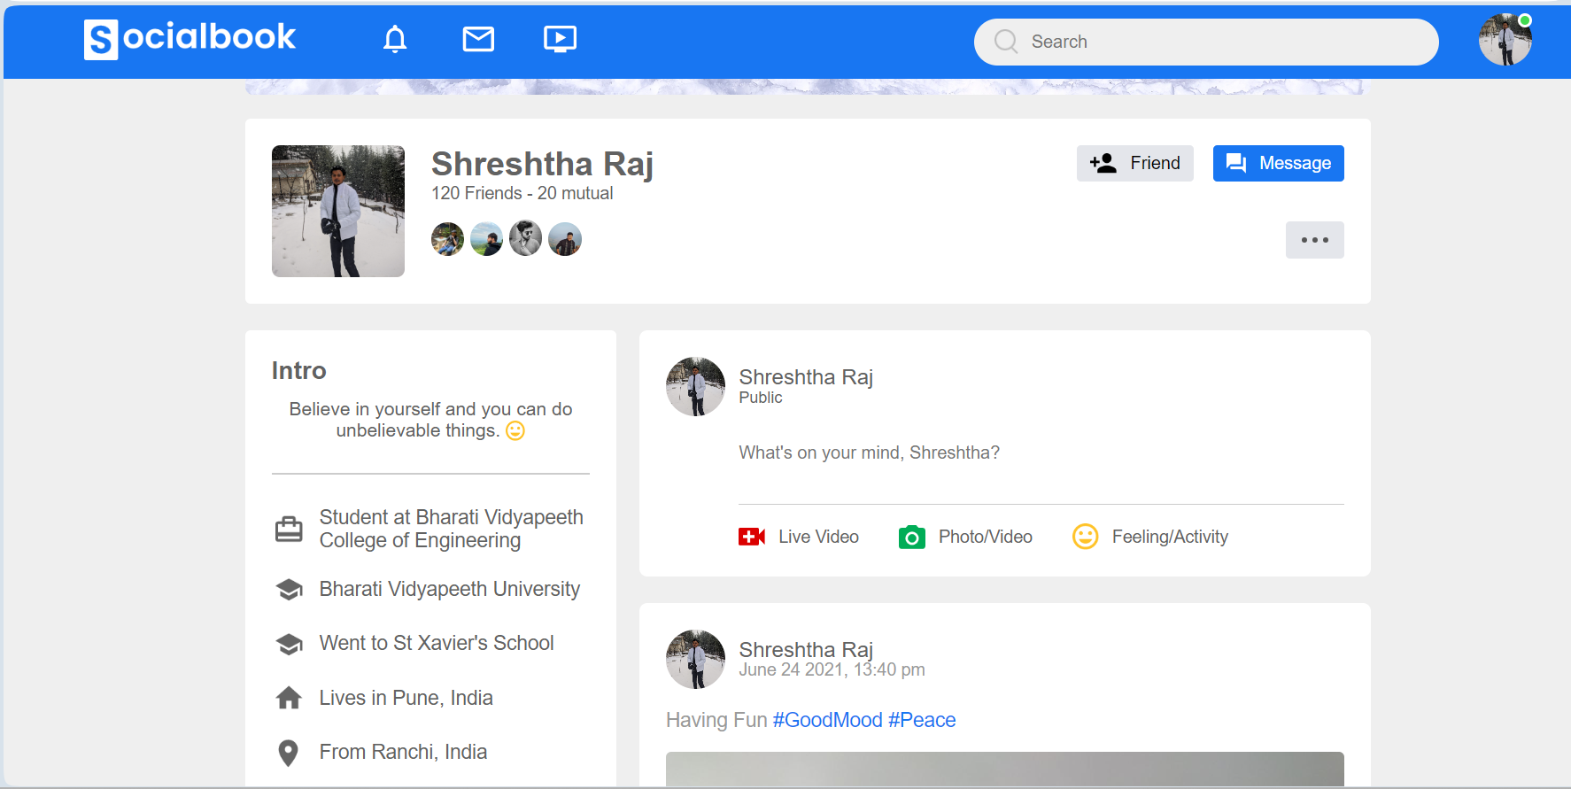
BVDUCOE ,PUNE SUBMITTED TO PROF. T.B.PATIL

Slide 18
THANK-YOU
BVDUCOE ,PUNE SUBMITTED TO PROF. T.B.PATIL

